Slide 1
Object-Oriented Systems Development:
Using the Unified Modeling Language
Chapter 1:
An Overview of Object-Oriented Systems Development

Slide 2

Goals
The object-oriented philosophy and why we need to study it.
The unified approach.

Slide 3
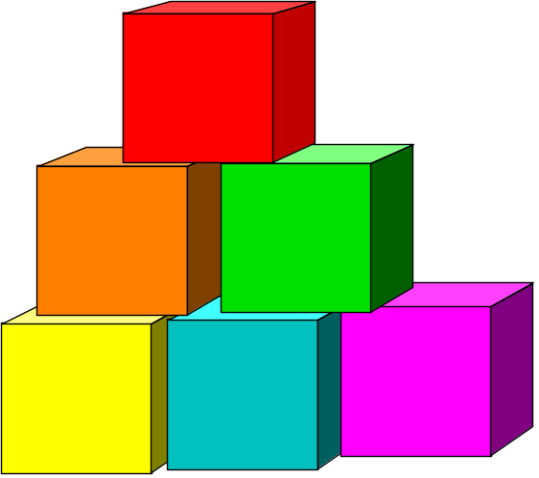
Introduction
Object-Oriented (OO) systems development is a way to develop software by building self-contained modules that can be more easily:
Replaced
Modified
and Reused.

Slide 4

What is a Software development methodology?
Practices, procedures, and rules used to develop software.

Slide 5
Systems Development Methodologies
Systems development methodology is a way to develop system.
A comprehensive system development methodology utilizes sets of tools as well as the style in which they are to be used.

Slide 6
Traditional Systems Development Methodology
Traditional or Structured approach is based on the idea that a system can be thought of as a collection of modules or subsystems.
It is much easier to work with a smaller cohesive module than a complex system.

Slide 7
Object-Oriented Systems Development Methodology
In an O-O environment, software is a collection of discrete objects.
These objects encapsulate their data and functionalities to model real world "objects."

Slide 8

Object-Oriented Systems Development Methodology (Con’t)
An object-oriented life cycle encourages a view of the world as a system of cooperative and collaborating agents.

Slide 9
Benefits of Object Orientation
Faster development,
Reusability,
Increased quality,
and easier maintenance.

Slide 10
OO Benefits (Con’t)
Object technology emphasizes modeling the real world and provides us with the stronger equivalence of the real world’s entities (objects) than other methodologies.
Raising the level of abstraction to the point where application can be implemented in the same terms as they are described.

Slide 11
Unified Approach
The unified approach (UA) is a methodology for software development that is used in this book.
The UA, based on methodologies by Booch, Rumbaugh, Jacobson, and others, tries to combine the best practices, processes, and guidelines.

Slide 12
Unified Approach (Con’t)
UA utilizes the unified modeling language (UML) which is a set of notations and conventions used to describe and model an application.

Slide 13
Layered Architecture
UA also uses a layered architecture to develop applications.
The layered approach consists of view or user interface, business, and access layers.

Slide 14

Layered Architecture (Con’t)
This approach reduces the interdependence of the user interface, database access, and business control.
Therefore, it allows for a more robust and flexible system.

Slide 15
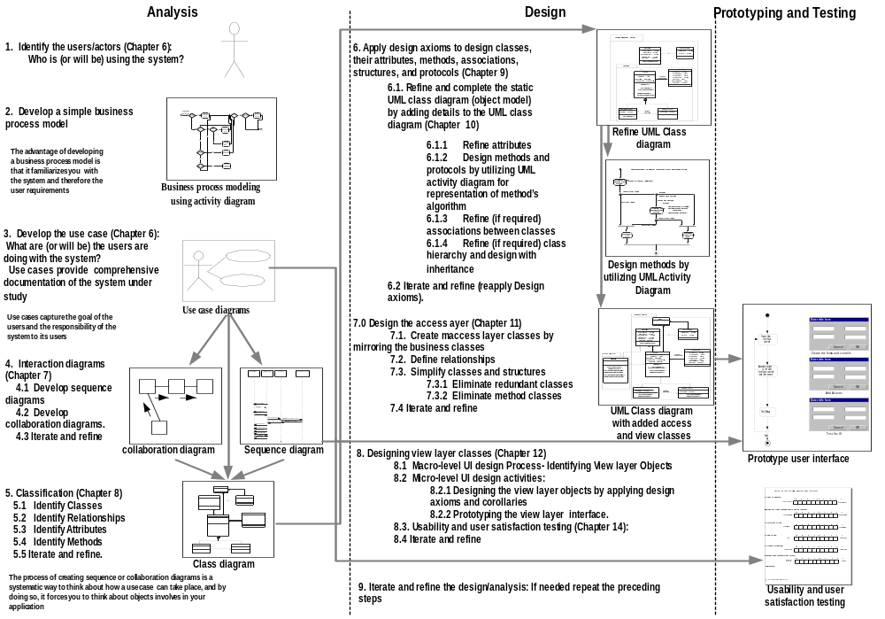

Slide 16

Summary
In an object-oriented environment, software is a collection of discrete objects that encapsulate their data and the functionality to model real-world objects.

Slide 17
Summary (Con’t)
An object orientation produces systems that are easier to evolve, more flexible, more robust, and more reusable than other traditional approaches.

Slide 18
Summary (Con’t)
This book is organized around the unified approach.
The UA, based on methodologies by Booch, Rumbaugh, Jacobson, and others, tries to combine the best practices, processes, and guidelines along with the Object Management Group's Unified Modeling Language (UML).

